Slide 1








Microservices Architecture with CI/CD Automation - L1
ECS Fargate/EC2, EventBridge, CloudMap
@TechWithNu

Slide 2
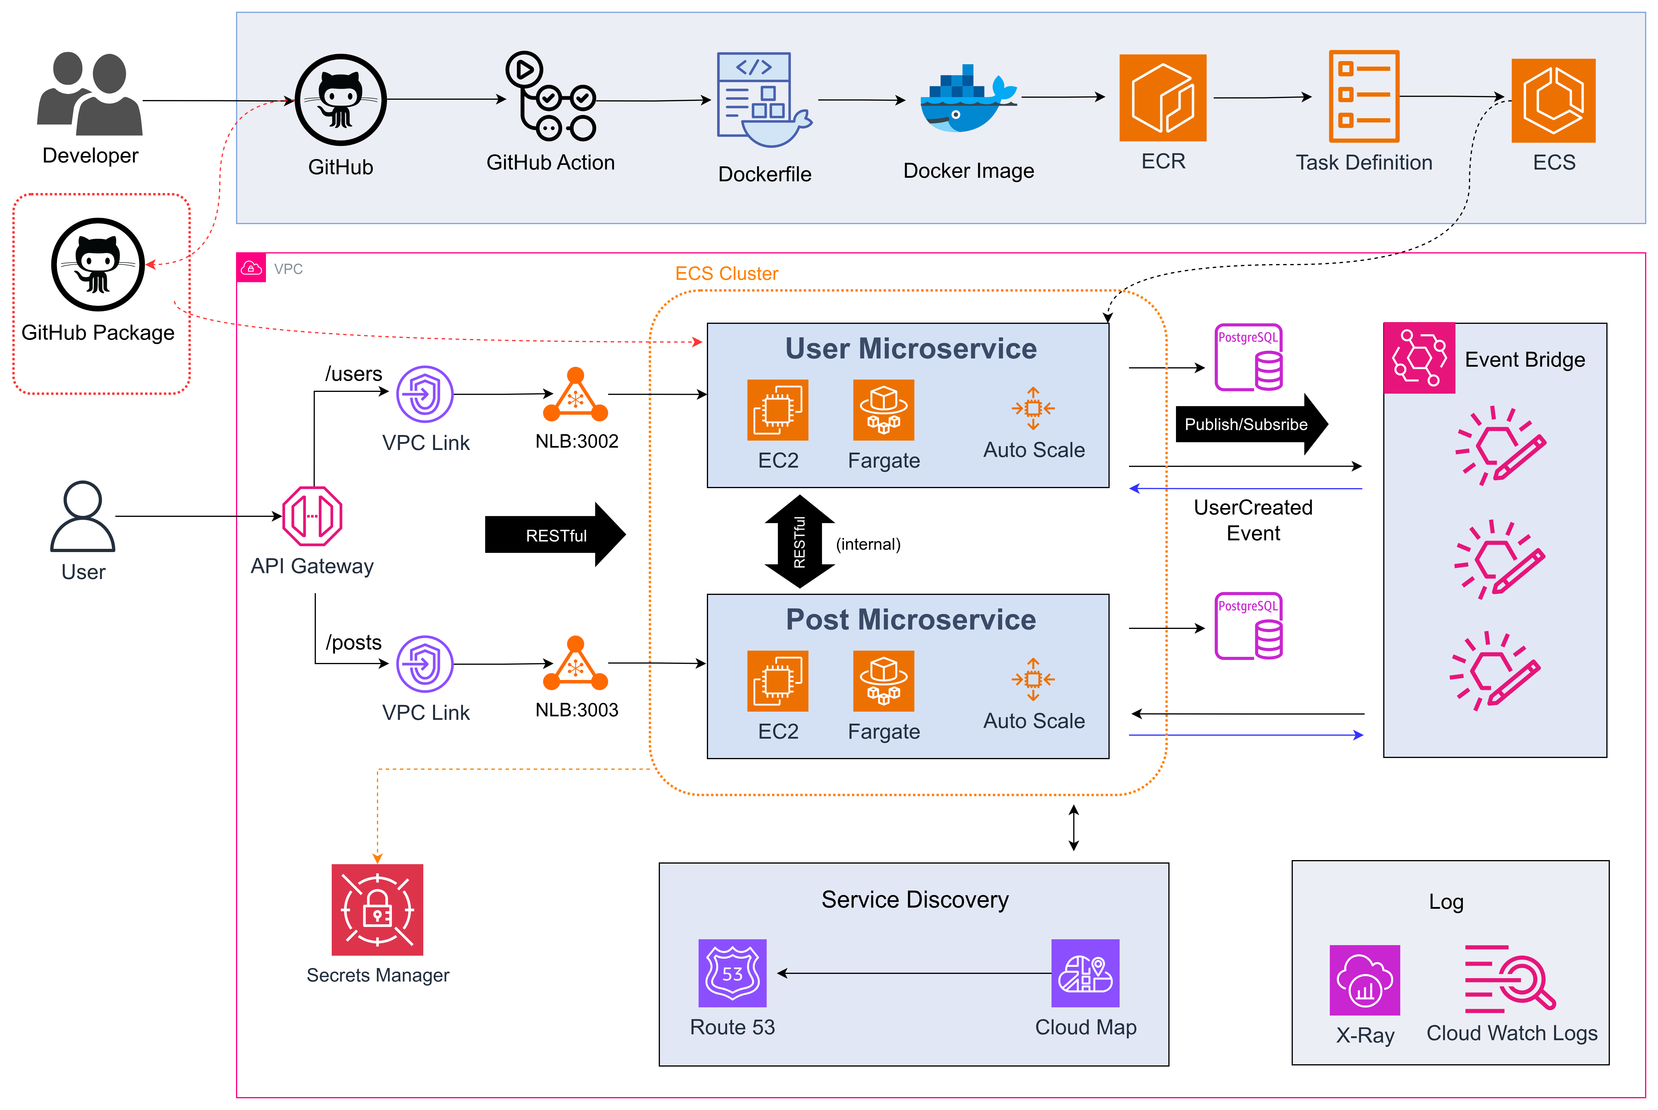

Slide 3
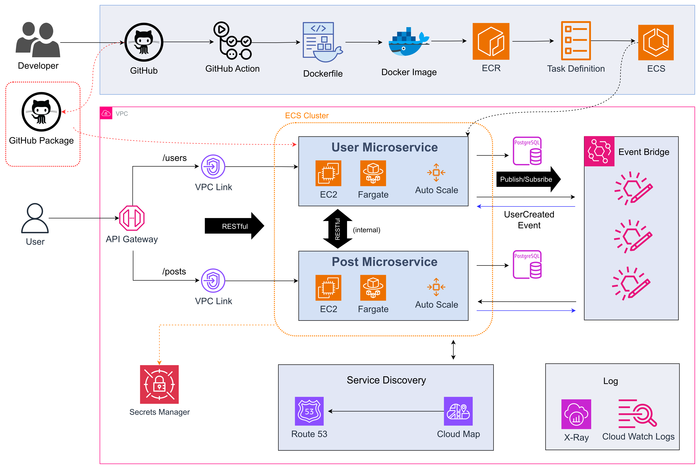

Slide 4




🍏 Microservices Blog (MVP)
USER SERVICE
DATABASE
POST SERVICE
USER AUTHENTICATION

Slide 5


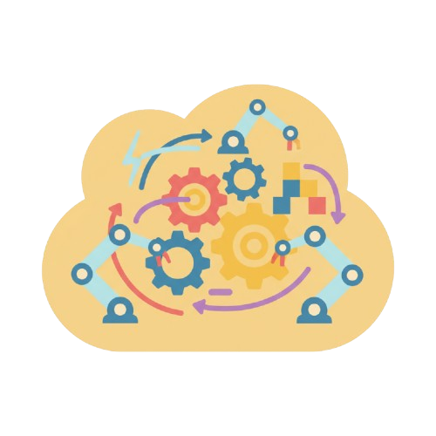
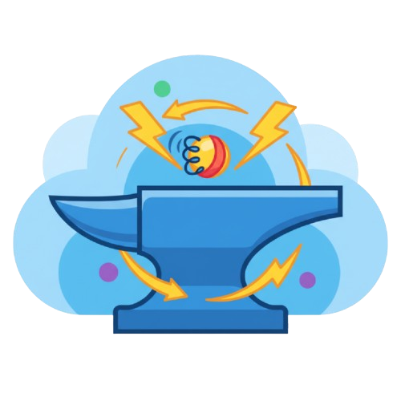
📐 Architectural Mindset
SCALABILITY
INDEPENDENCE
RESILIENCE
AUTOMATION

Slide 6
Service separation:
User service
Post service

Slide 7
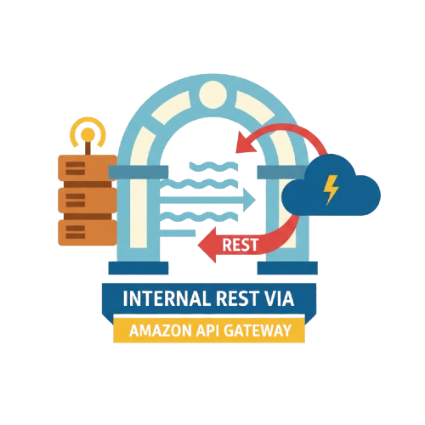

Communication between services:
Synchronous
Asynchronous
Internal REST via Amazon API Gateway
Amazon EventBridge/SNS

Slide 8
☁️ AWS Services Used
Component AWS Service
🖥️ Compute ECS Fargate/EC2 -> Run containers without managing EC2
🌐 API Gateway Amazon API Gateway (HTTP) -> Expose external APIs
🔎 Service Discovery AWS Cloud Map -> Internal service registry
🔔 Messaging/Event Amazon SNS or EventBridge -> Send events between microservices
🗄️ Database Amazon RDS (PostgreSQL) / DynamoDB -> Persistent data storage
📈 Monitoring Amazon CloudWatch + AWS X-Ray -> Logging, metrics & distributed tracing
🔄 CI/CD GitHub Action -> ECR -> ECS -> Automated build & deploy for each service
🔐 Secrets AWS Secrets Manager -> Securely store DB credentials

Slide 9



🔐 Security & IAM (Best Practices)
IAM Role per microservice (principle of “least privilege”)
IAM AssumeRole
API Gateway with `JWT Authorization` or `Lambda Authorizer`

Slide 10

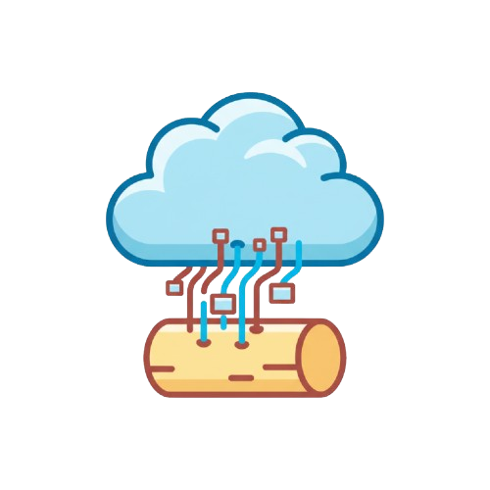
📊 Logging & Monitoring
Each service pushes logs to “CloudWatch Logs”
Trace inter-service call chains using “AWS X-Ray”

Slide 11

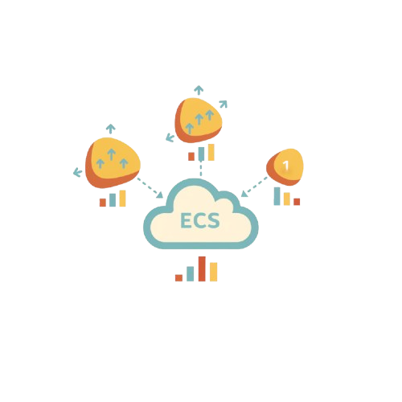
🧩 Scalability
Each service scales independently on ECS
Database can follow “database-per-service”

Slide 12
🛠️
DevOps & CI/CD

Slide 13
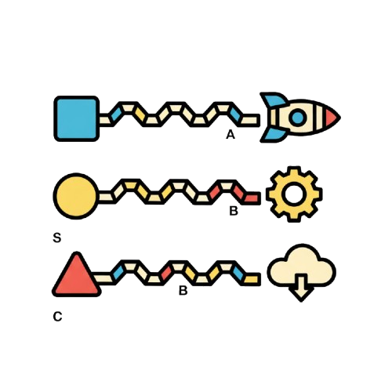
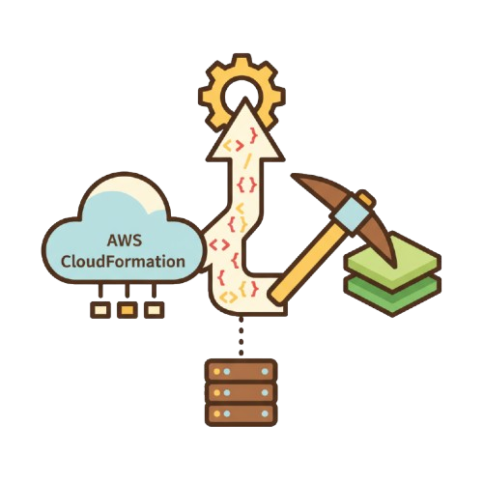
🛠️ DevOps & CI/CD
Each service has its own deployment pipeline
Typical pipeline: “GitHub → ECR → ECS Deploy”
Use `Infrastructure as Code` with “AWS CloudFormation / Terraform”

Slide 14
Table of Contents
🧩 1. CI/CD Pipeline
🧠 2. Microservice Architecture
🚀 3. EC2/IMA/LaunchTemplate/ASG
⚙️ 4. API Gateway
💻 5. Conclusion

Slide 15
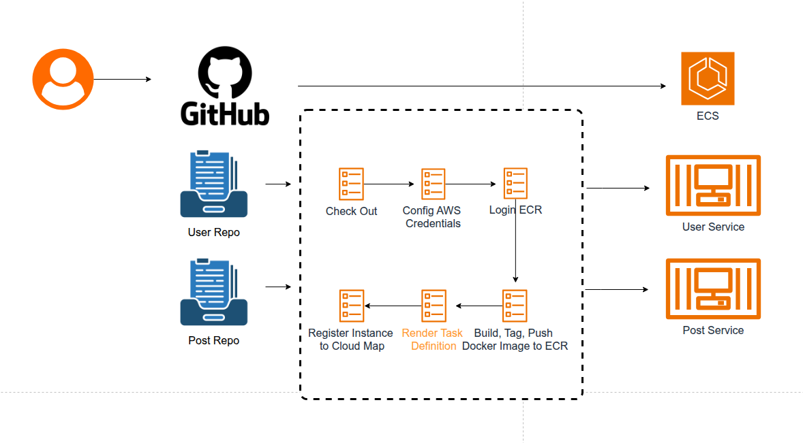

Slide 16
🎯 CI/CD Pipeline
📥 Checkout Source Code
🔐 Configure AWS Credentials
🐳 Login to Amazon ECR
🛠️ Build & Push Docker Image
📄 Render ECS Task Definition
🚢 Deploy to Amazon ECS
🌐 Register Instance to Cloud Map

Slide 17
🎯 CI/CD Pipeline
How to Add Secrets & Variables in GitHub Repository
Settings → Secrets and variables → Actions → New Repository secret
AWS_ACCESS_KEY_ID
AWS_SECRET_ACCESS_KEY
AWS_REGION
ECR_REPOSITORY
ECS_CLUSTER
ECS_SERVICE
ECS_PORT

Slide 18

Swagger

Slide 19
Table of Contents
⚙️ 1. Install Swagger on each Service
⚙️ 2. Install Swagger on root
⚙️ 3. API Gateway

Slide 20
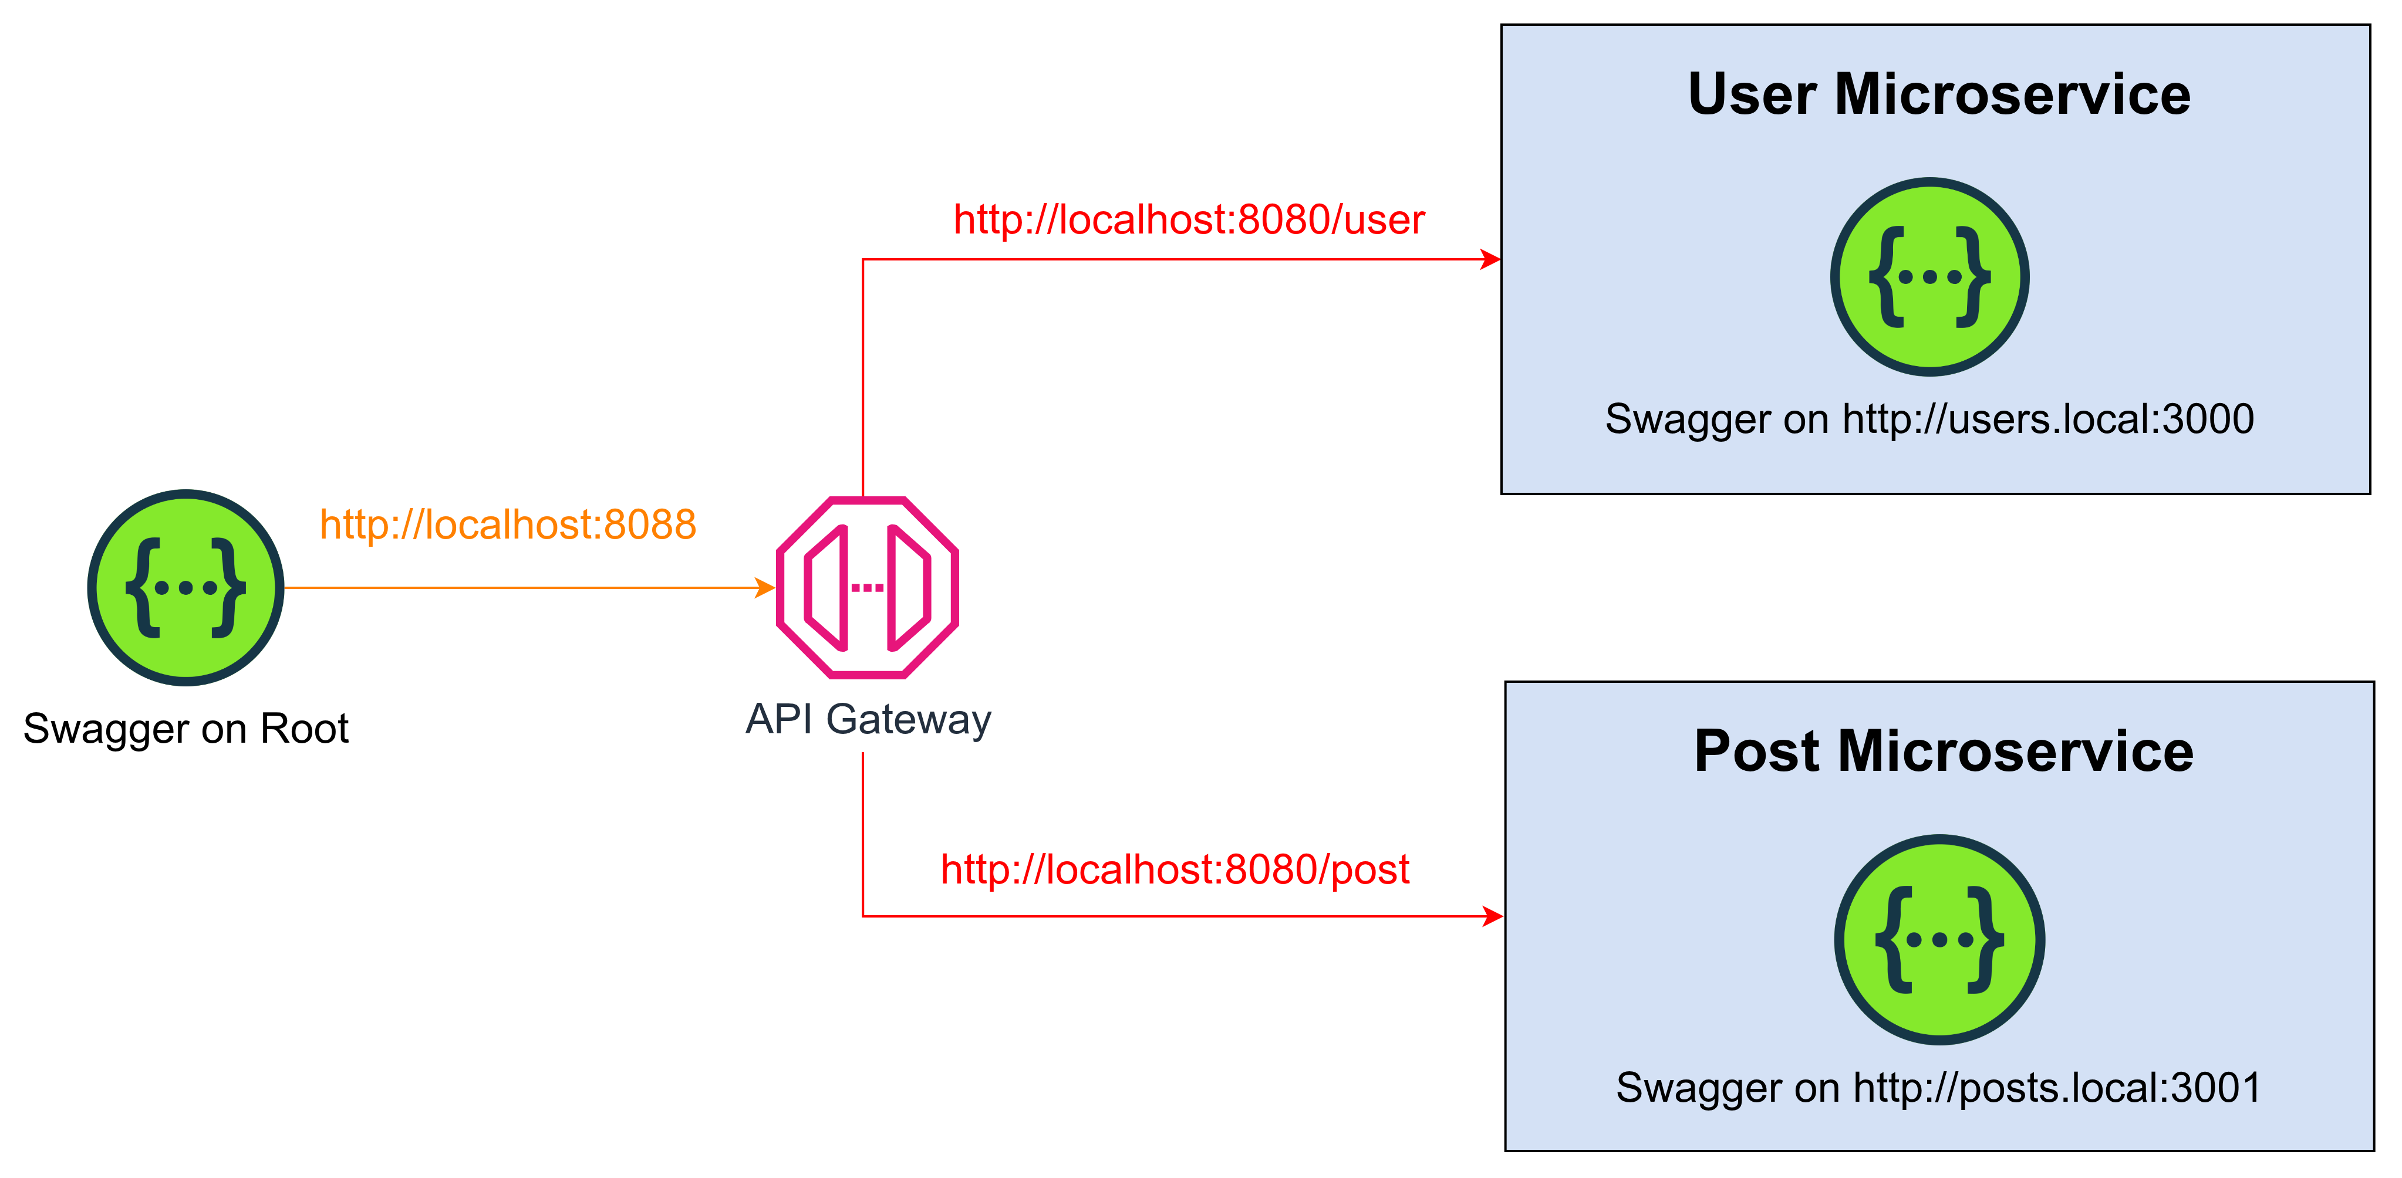

Slide 21
⚙️ 1. Install Swagger on each Service
/services/post-service/package.json
{
"name": "post-service",
"dependencies": {
"swagger-ui-express": "^5.0.1",
"swagger-jsdoc":"^6.2.8"
}
}

Slide 22
⚙️ 2. Install Swagger on root
/services/swagger-service/package.json
{
"name": "swagger-service",
"dependencies": {
"swagger-ui-express": "^5.0.1"
}
}

Slide 23
⚙️ 3. API Gateway
events {}
http {
server {
listen 8080;
# Swagger UI
location / {
root /usr/share/nginx/html;
index index.html;
try_files $uri $uri/ /index.html;
}
# Reverse Proxy for Post Service
# Reverse Proxy for User Service
}
}

Slide 24
⚙️ 3. API Gateway
events {}
http {
server {
.....
# Reverse Proxy for Post Service
location /posts/ {
proxy_pass http://post-service:3003/;
}
# Reverse Proxy for User Service
location /users/ {
proxy_pass http://user-service:3002/;
}
}
}

Slide 25

Github Package

Slide 26
Table of Contents
📁 1. Create the `shared-lib` repository
📦 2. Write a proper `package.json`
🔑 3. Generate a GitHub token
📝 4. Create `.npmrc`
🚀 5. Publish the package to GitHub
➕ 6. Add it to the `post-service`
🐳 7. Build Docker image with token

Slide 27
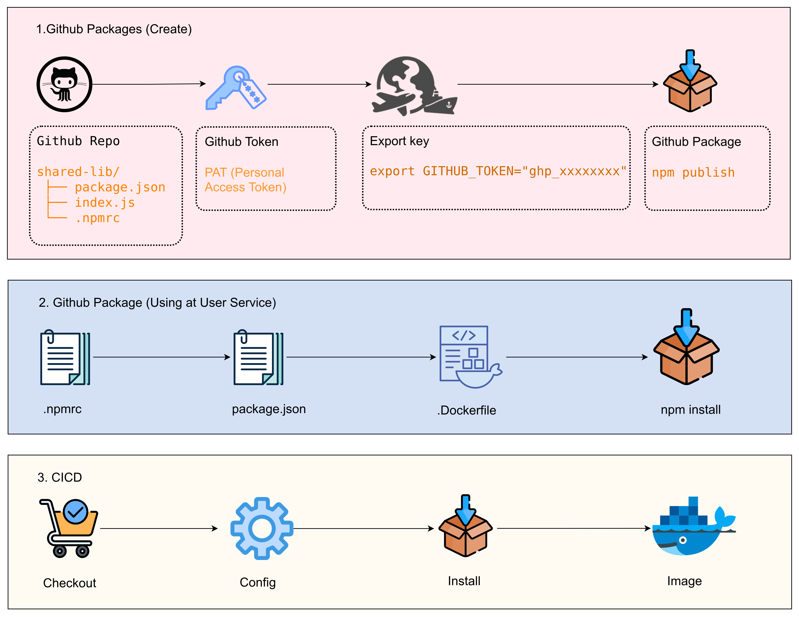

Slide 28

Root repo, submodule

Slide 29
Table of Contents
📁 1. Create a Git repository for each service
📂 2. Create a root repository that contains all submodules
🔗 3. Add each service to the root repository as a Git Submodule
❓ 4. What should a new developer do when cloning the project?
♻️ 5. What to do when you update a service's code
👨‍💻 6. What happens when a new developer modifies a service
⚠️ 7. The golden rules when working with submodules (very important!!)

Slide 30
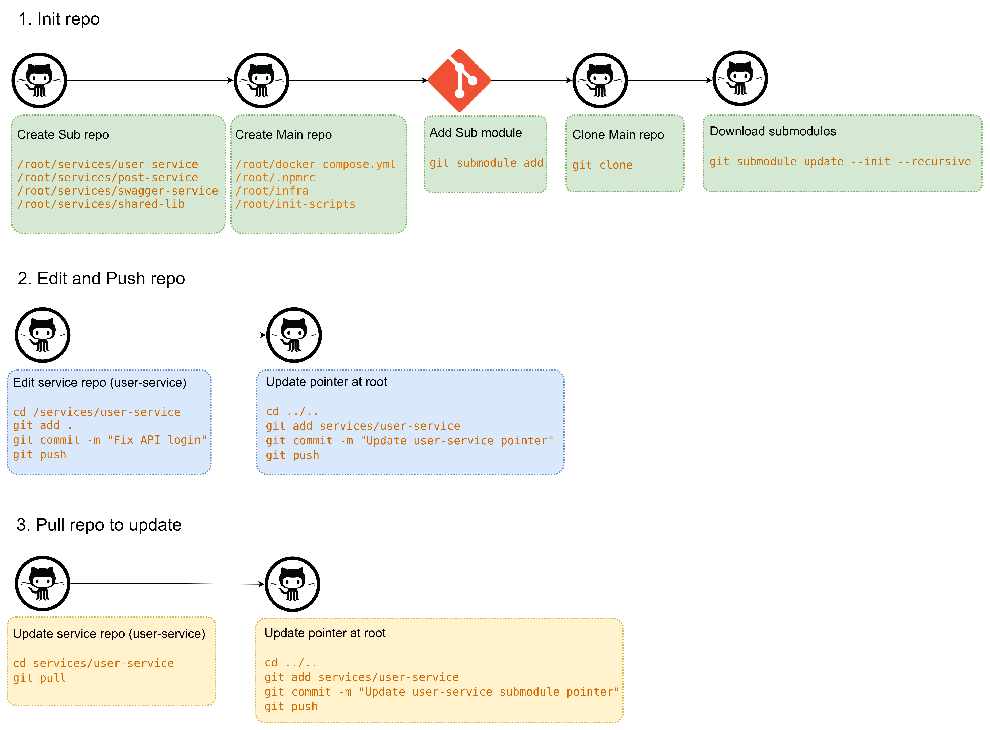

Slide 31

Microservices Architecture

Slide 32



Microservices Architecture
System Components:
Amazon EventBridge
(Event-driven Communication)
Amazon Cloud Map
(Service Discovery)
User Service
Post Service
Shared Libraries

Slide 33
👤 User Service
🛠️ Responsibilities
🔐 Manage users & authentication
🧾 Provide user profile data
📡 Emit domain events to EventBridge, including:
✨ UserCreated
🔄 UserUpdated
🔗 Integration
🗺️ Registered in AWS Cloud Map for internal service discovery
📚 Uses Shared Libraries to standardize DTOs and reusable business logic

Slide 34
📝 Post Service
🛠️ Responsibilities
🧩 Handle post-related operations (create, update, list)
🔄 Consume asynchronous events from EventBridge
📌 Example: update posts when a user changes name
🔗 Integration
🗺️ Access User Service via Cloud Map
📚 Uses Shared Libraries for consistency
🪶 Decoupled from User Service → reduces direct dependencies

Slide 35
📦 Shared Libraries
Role:
📦 Package reusable logic/common libraries for services:
🛠️ Utilities (event-bus, authenticate-token, logger, error handler..)
Published to:
📦 Private NPM Registry (Node.js)
📦 Private Composer Registry (PHP)
🗄️ or S3 + versioning
Benefits:
✅ Reduces code duplication
✅ Ensures consistency across services
✅ Easier updates and maintenance

Slide 36

Communicate: Synchronize, Asynchronize

Slide 37
Table of Contents
🔄 1. Synchronous Communication
📡 2. Asynchronous Communication

Slide 38
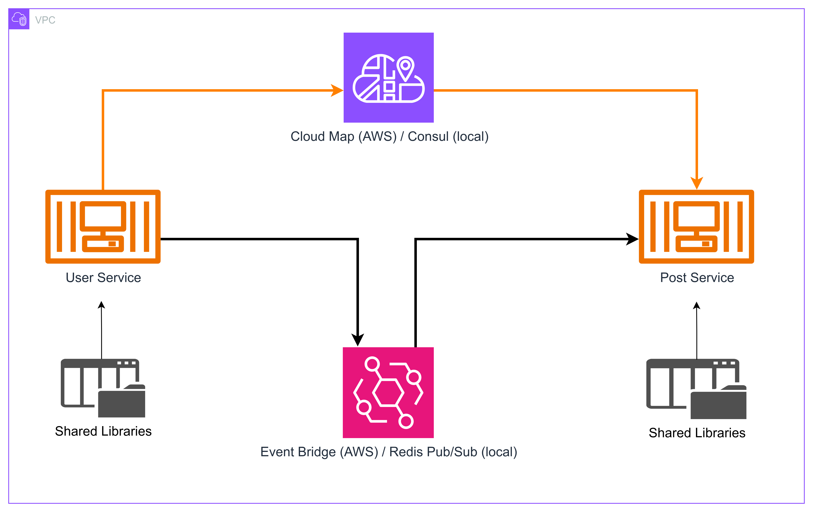

Slide 39
🌐 Amazon Cloud Map – Service Discovery
Role:
📝 Register & manage service instances
🔍 Allow microservices to discover each other by name instead of IP
⚡ Automatically update instances when ECS deploys a new version
Example:
👤 User Service registered as:
user.api.local
📝 Post Service calls:
http://user.api.local:3000

Slide 40
🔔 Amazon EventBridge – Event-Driven Architecture
Role:
⚡ Enables asynchronous communication between microservices
🔗 Fully decouples User Service and Post Service
Example Flow:
👤 User Service emits UserCreated event
🛣️ EventBridge routes the event to Post Service
📝 Post Service processes and updates related data
Benefits:
✅ Loose coupling between services
➕ Easy to add new services without modifying existing code
🚀 Optimized performance via asynchronous processing

Slide 41
🧩 Architecture Summary
Component Role
👤 User Service Manage users, emit events
📝 Post Service Handle posts, consume events
📦 Shared Libraries Reusable logic, reduce duplication
🗺️ Cloud Map Service discovery
⚡EventBridge Event routing & async communication

Slide 42

EC2

Slide 43
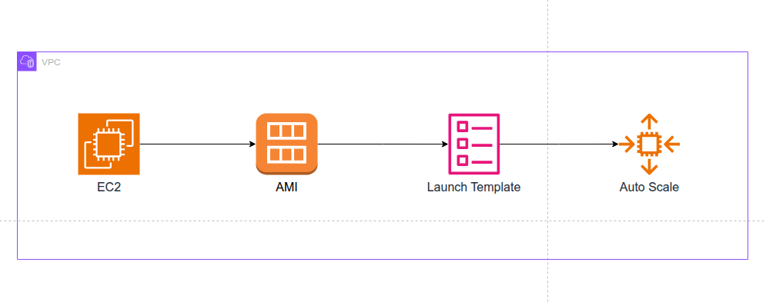

Slide 44
⚙️ Table of Content (EC2)
🖥️ Create an EC2 instance → install Docker + ECS Agent.
📦 Create an AMI from that EC2 instance.
📝 Use this AMI in the Launch Template.
🚀 Create an Auto Scaling Group (ASG) → enable Spot Instances → attach it to the ECS Cluster.

Slide 45
🪜 STEP 1: Create an EC2 Instance and Install Docker + ECS Agent
1.1. Create the EC2 Instance:
Step Description
🚀 Launch Go to EC2 Console → Launch Instance
🐧 OS Amazon Linux 2 (x86_64 / arm64)
⚙️ Type t3.small
🔑 Key Pair Select or create new
🌐 Network Default VPC or ECS Cluster VPC
💾 Storage Default 8–20 GB
🔐 Security Group Port 22 (SSH), 80 (optional)

Slide 46
🪜 STEP 1: Create an EC2 Instance and Install Docker + ECS Agent
1.2. SSH into the EC2 instance (optional)
ssh -i your-key.pem ec2-user@<EC2_PUBLIC_IP>

Slide 47
🪜 STEP 1: Create an EC2 Instance and Install Docker + ECS Agent
1.3. Install Docker
sudo yum update -y
sudo amazon-linux-extras install docker -y
sudo service docker start
sudo usermod -a -G docker ec2-user

Slide 48
🪜 STEP 1: Create an EC2 Instance and Install Docker + ECS Agent
1.4. Install the ECS Agent
sudo mkdir -p /etc/ecs
echo "ECS_CLUSTER=your-ecs-cluster-name" | sudo tee /etc/ecs/ecs.config
sudo docker run --name ecs-agent --detach --restart=always \
--volume=/var/run/docker.sock:/var/run/docker.sock \
--volume=/var/log/ecs/:/log \
--volume=/var/lib/ecs/data:/data \
--net=host \
--env-file=/etc/ecs/ecs.config \
amazon/amazon-ecs-agent:latest

Slide 49


🧱 STEP 2: Create an AMI from this EC2 Instance
In EC2 Console → Instances, select the EC2 instance you created.
Go to Actions → Image and templates → Create Image
Fill in:
- Name: ecs-docker-custom-ami
- Description: Custom ECS Image with Docker & Agent
Click Create Image

Slide 50

⚙️ STEP 3: Create a Launch Template
EC2
Launch Template
Go to EC2 Console → Launch Templates → Create launch template

Slide 51
⚙️ STEP 3: Create a Launch Template
Enter the following:
Item Details
⭐ Name ecs-spot-template
🖥️ AMI Select the AMI you just created
💻 Instance Type t3.small
🔑 Key Pair Choose the key for SSH access
🛡️ Security Group Select the existing group
👤 IAM Role ECS Instance Role (with ECS + CloudWatch permissions)

Slide 52
⚙️ STEP 3: Create a Launch Template
Advanced details:
User data (optional, if needed):
#!/bin/bash
echo "ECS_CLUSTER=your-ecs-cluster-name" > /etc/ecs/ecs.config
Spot instances: enable ✅ “Request Spot Instances”
Allocation strategy: “capacity-optimized”
Spot instance request type: “persistent”
Create the template

Slide 53
🚀 STEP 4: Create an Auto Scaling Group (ASG)
Go to EC2 → Auto Scaling Groups → Create Auto Scaling group
Icon Details
⭐ Name ecs-asg-spot
🧩 Launch Template Select ecs-spot-template (the template created earlier)
🌐 Network Select the “VPC and Subnets” used by your ECS Cluster
⚖️ Load Balancing Select your “ECS Cluster” → you will see the Attach option
📊 Desired Capacity Min = 1 • Max = 5 • Desired = 1 (start small)
📈 Scaling Policy Target Tracking (e.g., CPU > 70% → scale out)
Review → Create ASG

Slide 54
🔀
API Gateway

Slide 55
🔀 API Gateway
☁️ API #1: /users
🔧 Key Features
📝 Register — Create a new user account
🔐 Login — Authenticate user and return JWT
📃 List Users — Retrieve all users
❌ Delete User — Remove a user by ID
🔄 Mini Flow
Client → API Gateway (JWT Authentication) → User Service → Database
User Service ← EventBridge (optional events: UserCreated, UserDeleted)

Slide 56
🔀 API Gateway
☁️ API #2: /posts
🔧 Key Features
➕ Create Post — Add a new post
📄 List Posts — Retrieve all posts
🗑️ Delete Post — Remove a post by ID
🔄 Mini Flow
Client → API Gateway (JWT Validate) → Post Service → Database
Post Service ← EventBridge (optional events: PostCreated, PostDeleted)

Slide 57
✨ Conclusion
@TechWithNu

Slide 58
🗄️
On-Premise Overview

Slide 59
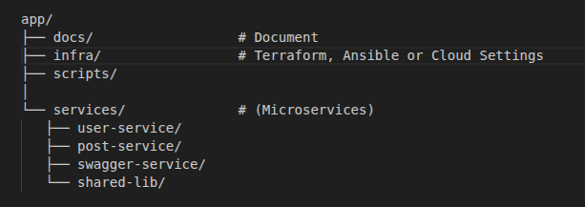
Folder Structure

Slide 60
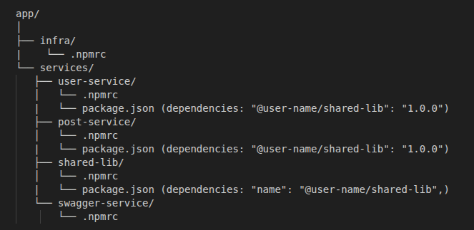
Github Package

Slide 61
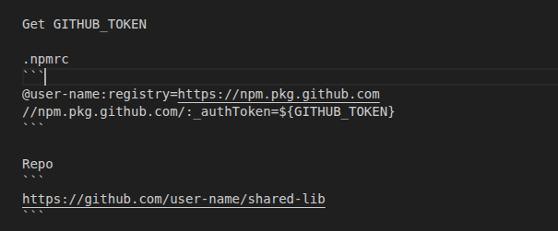
Github Package

Slide 62
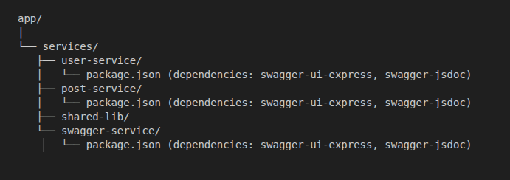
Swagger

Slide 63
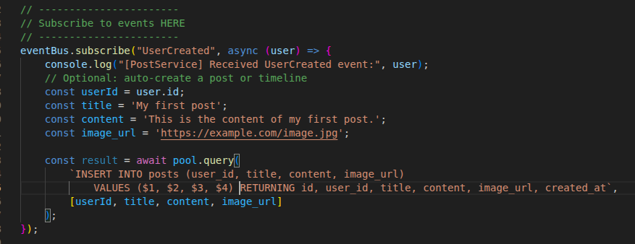
EventBus

Slide 64
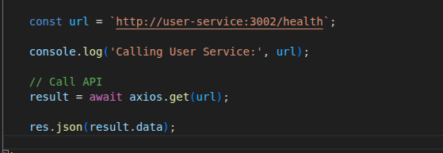
Service Discovery

Slide 65
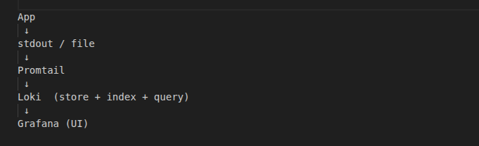
Logging

Slide 66
☁️
On Cloud

Slide 68
🔁 Flow on Cloud
1️⃣ Security Credentials
2️⃣ VPC + Security Group
3️⃣ RDS
4️⃣ ECR
5️⃣ IAM Roles (Task / Execution)
6️⃣ ECS Cluster + Task Definition
7️⃣ Target Group
8️⃣ Load Balancer
9️⃣ Cloud Map
🔟 Event Bus (EventBridge / SNS / SQS)
1️⃣1️⃣ API Gateway + VPC Link
🔁 CI/CD + npm packages

Slide 69
1️⃣ Security Credentials

Slide 70
2️⃣ VPC + Security Group

Slide 71
3️⃣ RDS

Slide 72
4️⃣ ECR

Slide 73
5️⃣ IAM Roles (Task / Execution)

Slide 74
6️⃣ ECS Cluster + Task Definition

Slide 75
7️⃣ Target Group

Slide 76
8️⃣ Load Balancer

Slide 77
9️⃣ Cloud Map

Slide 78
🔟 Event Bus (EventBridge/SNS/SQS)

Slide 79
1️⃣1️⃣ API Gateway + VPC Link

Slide 80
🔁 CI/CD + npm packages

Slide 81
@TechWithNu

Slide 82
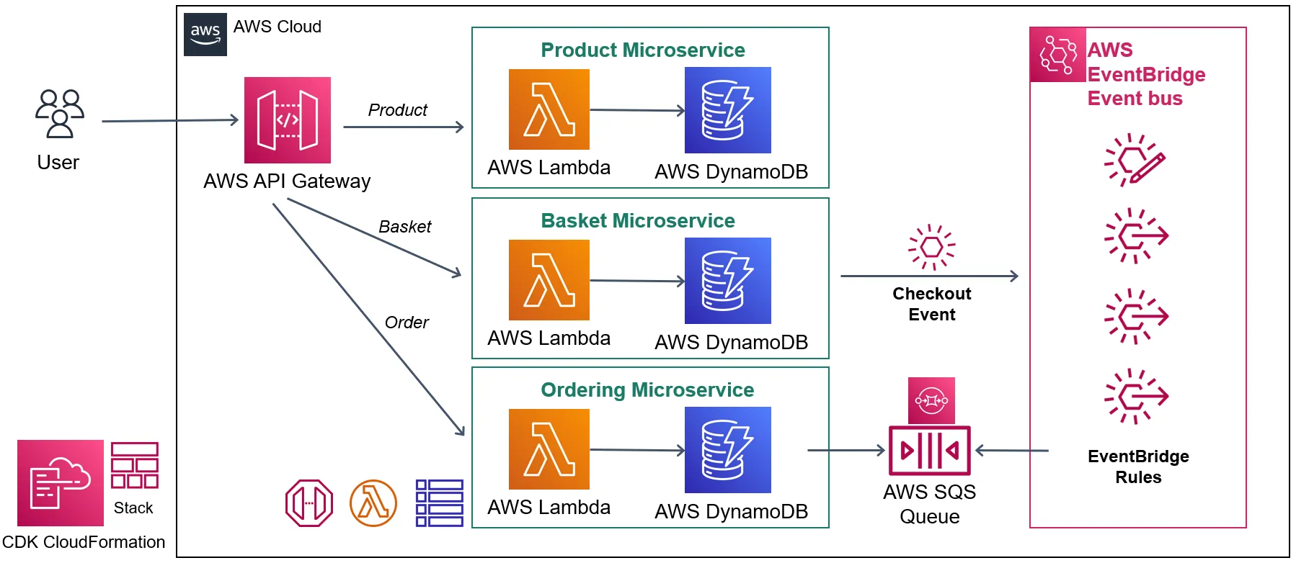

Slide 83
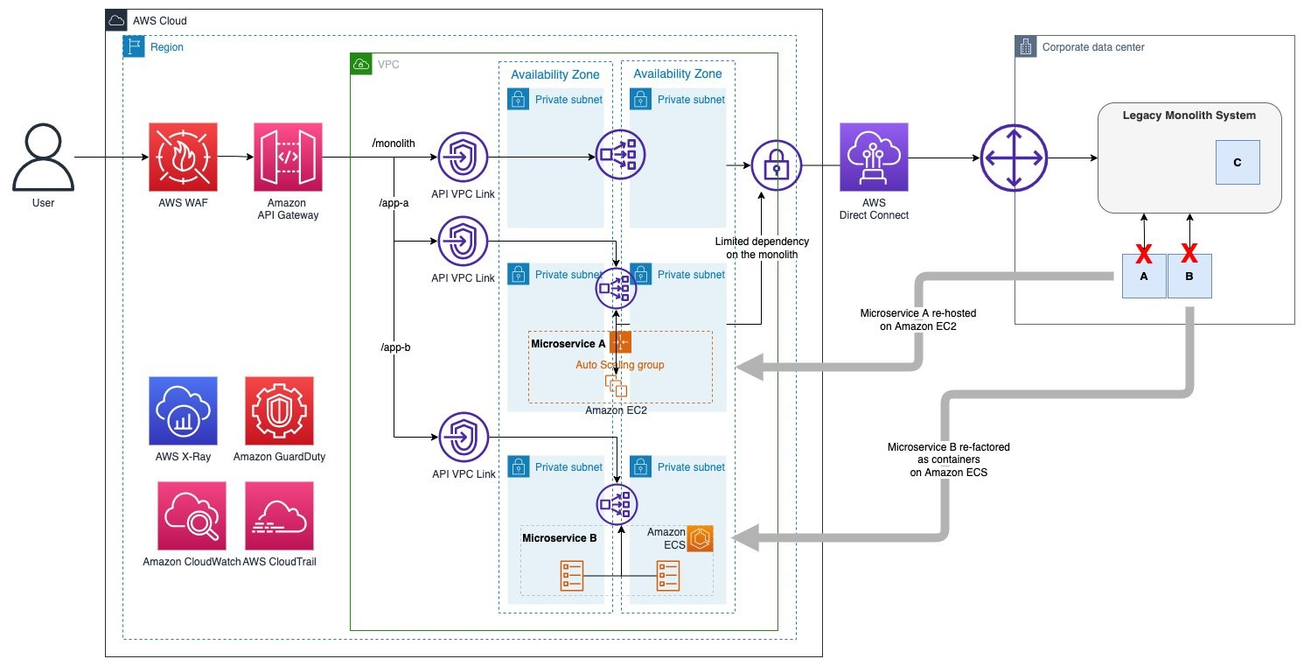

Slide 84
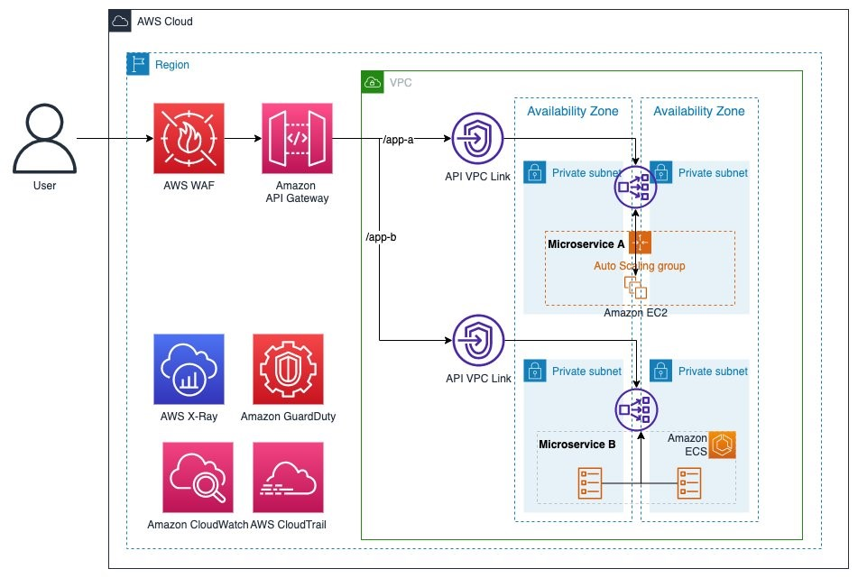

Slide 85
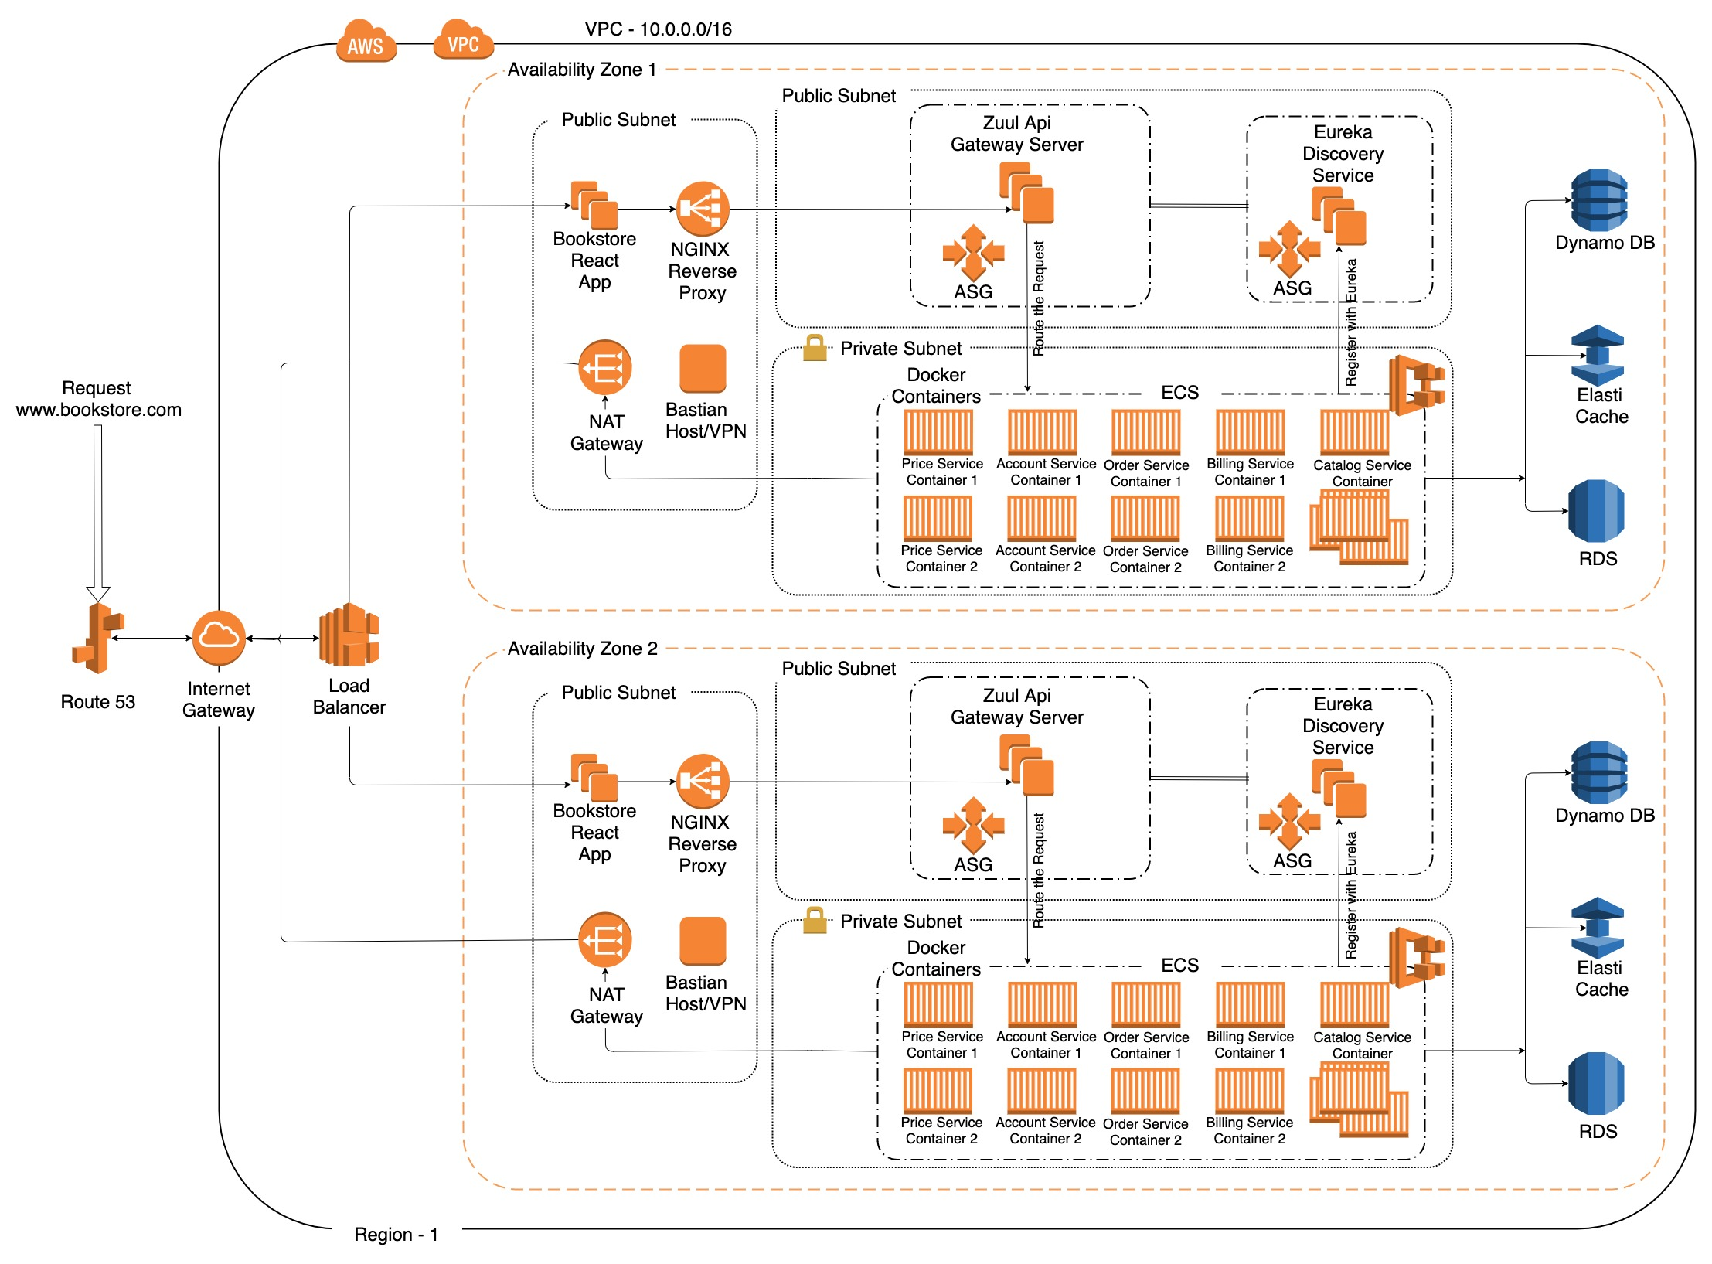

Slide 86
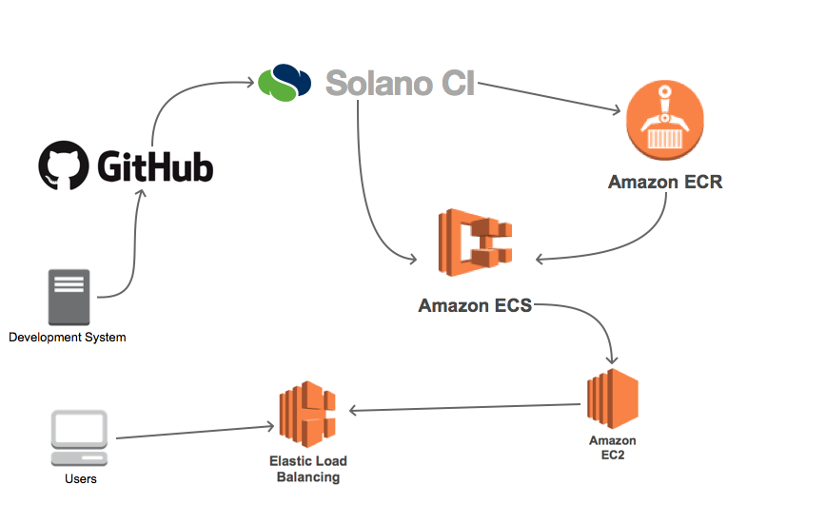

Slide 87
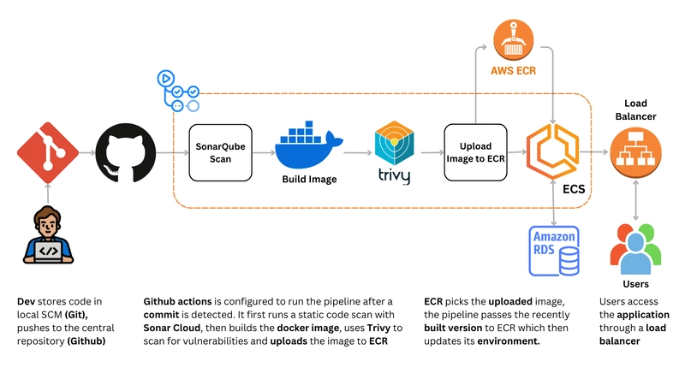

Slide 88
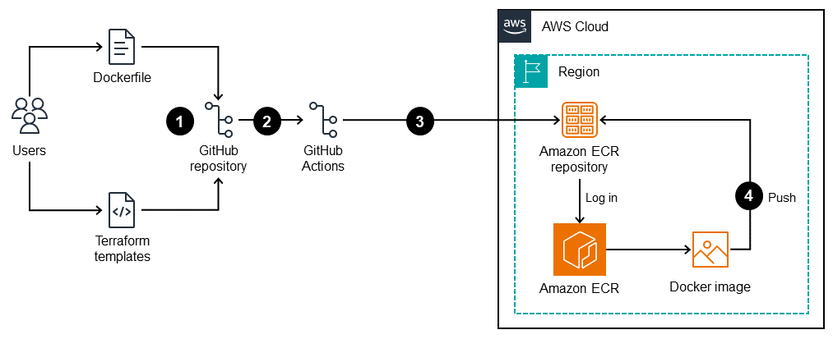

Slide 89
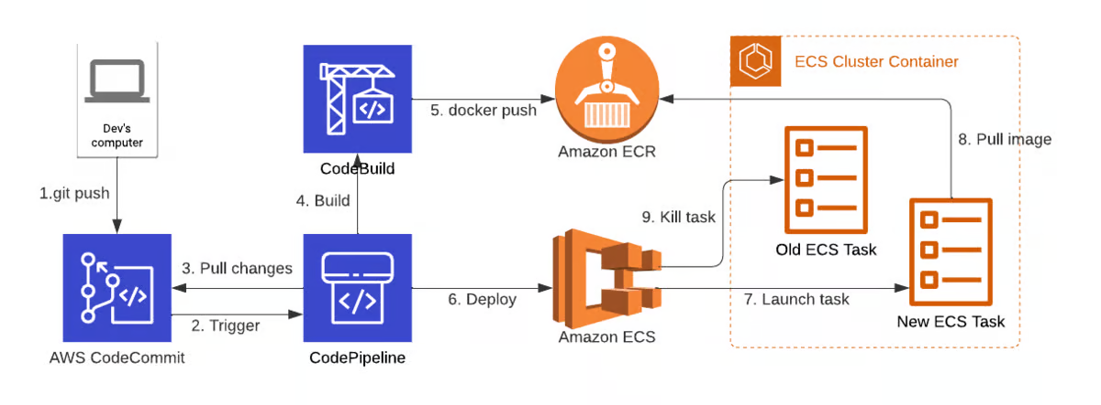

Slide 90
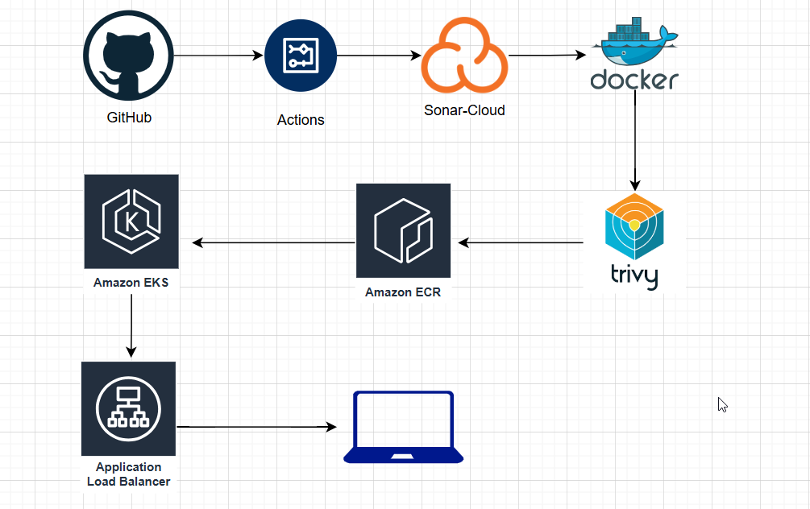

Slide 91
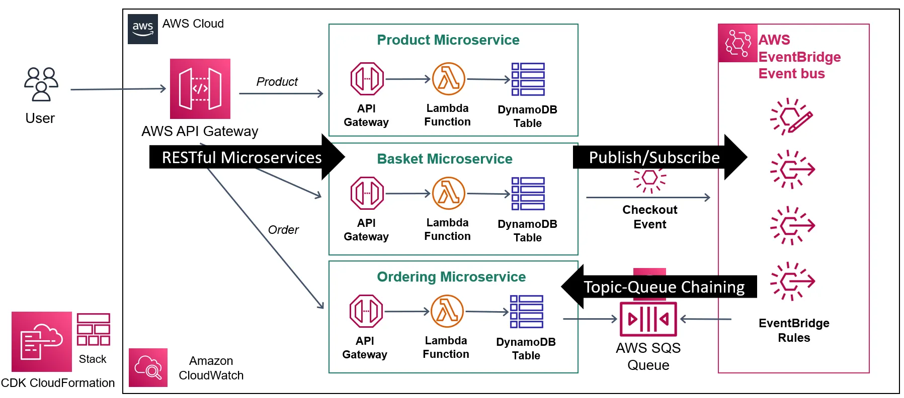

Slide 92
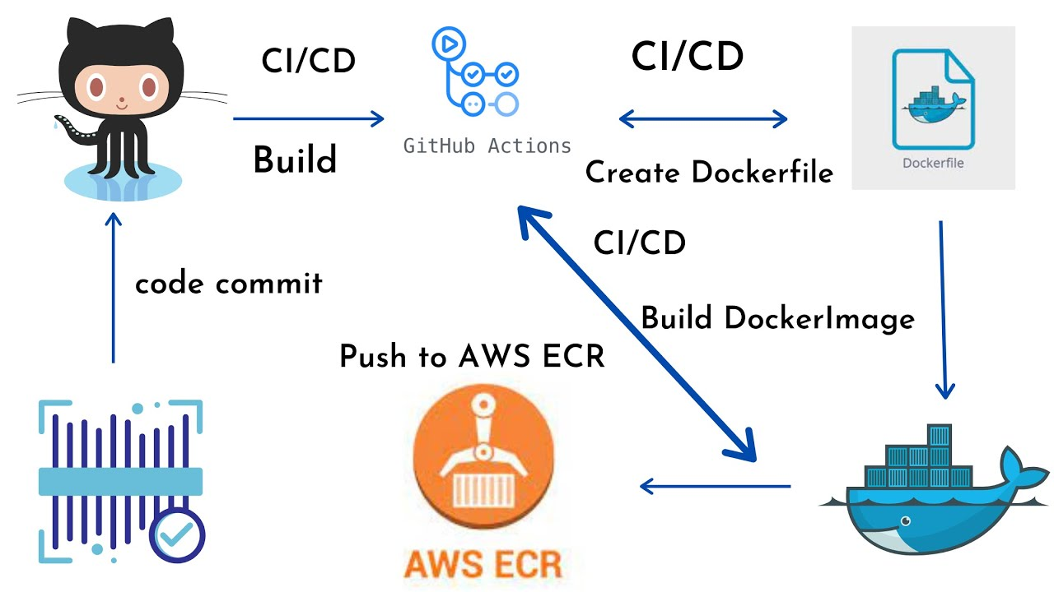

Slide 93
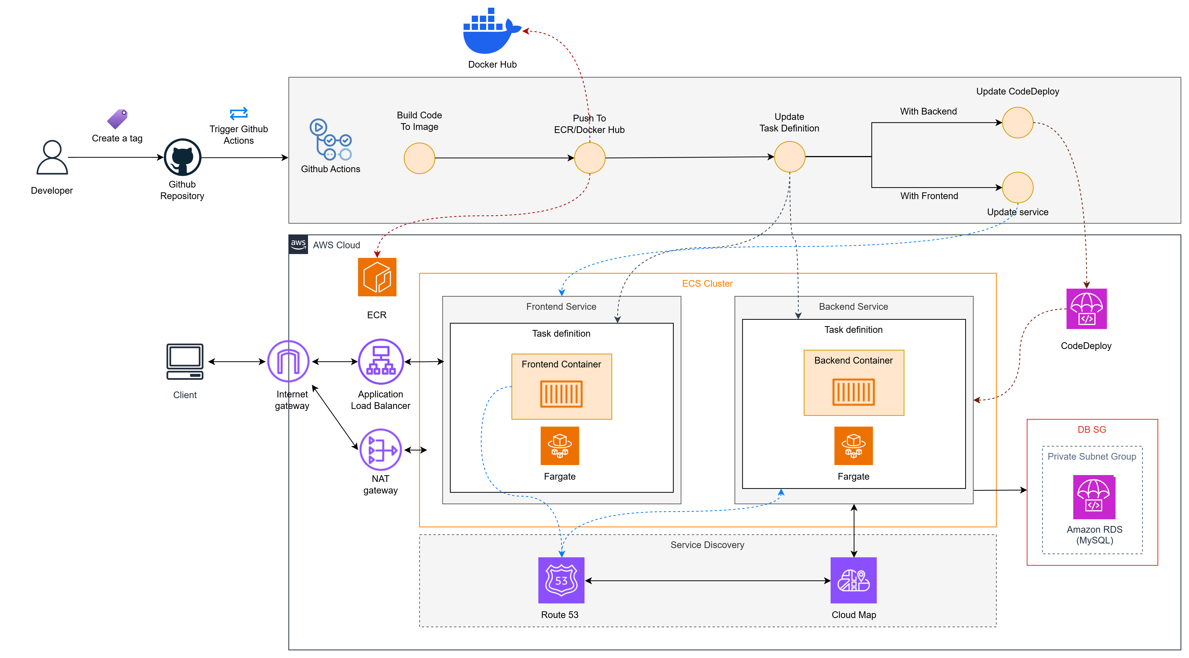

Slide 94
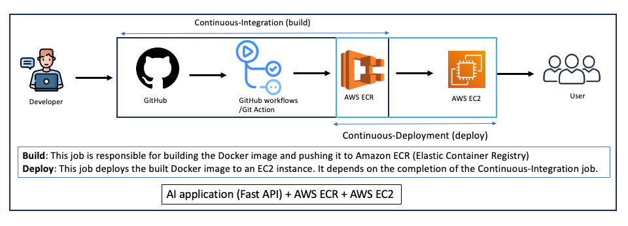

Slide 95
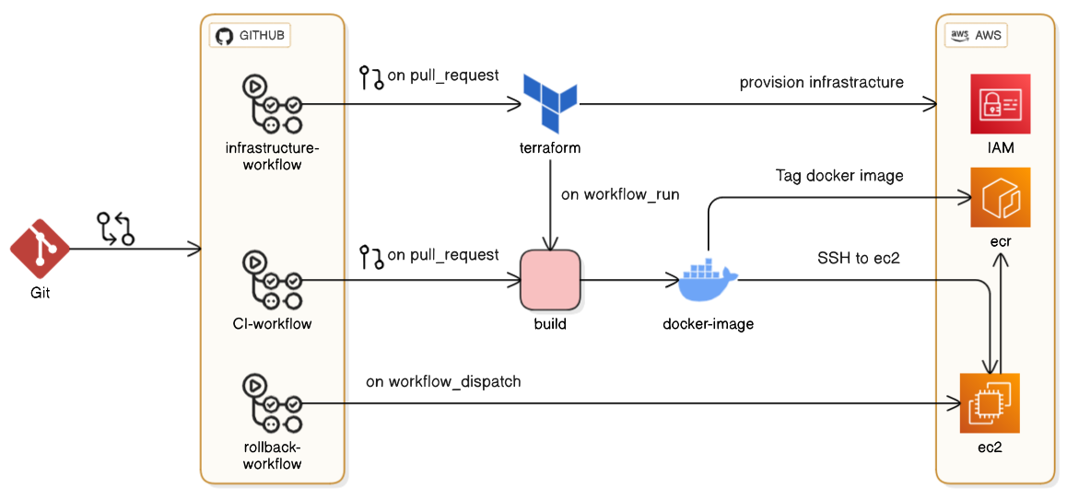

Slide 96
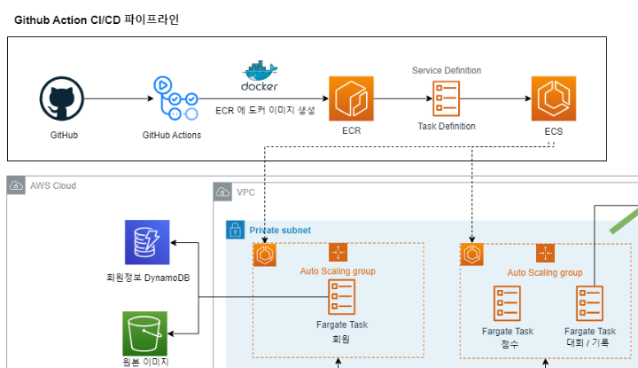

Slide 97
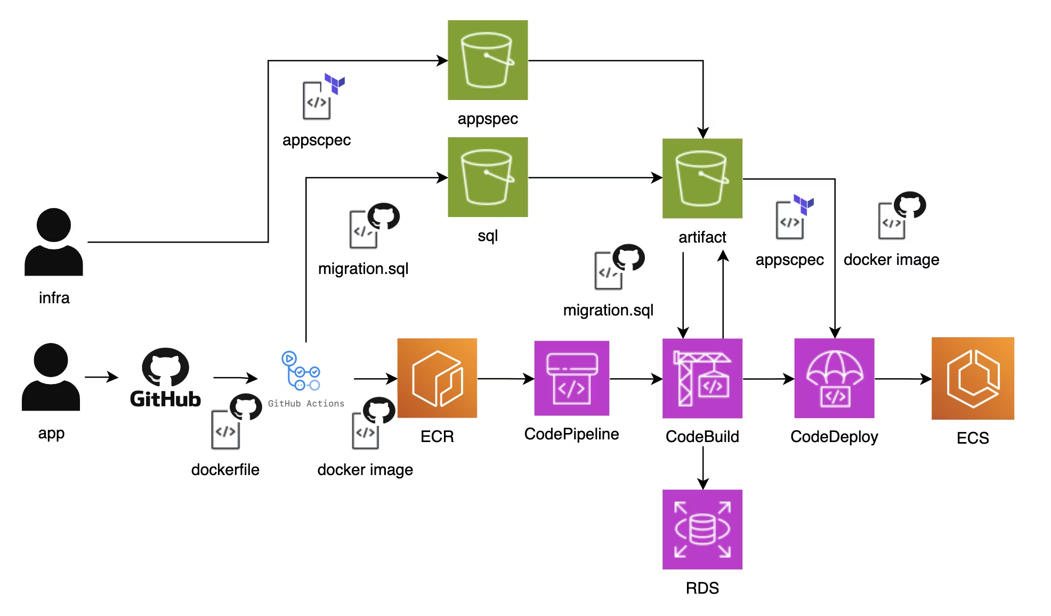

Slide 98
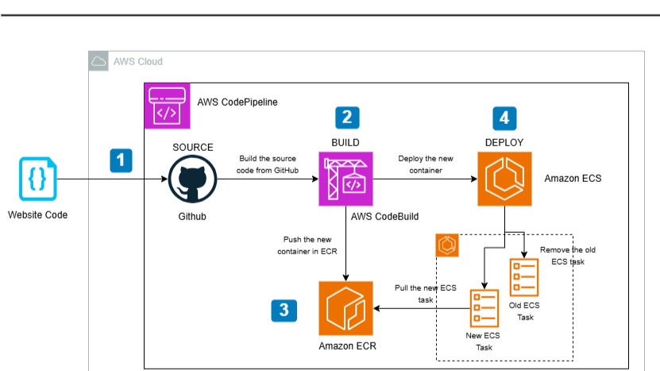

Slide 99
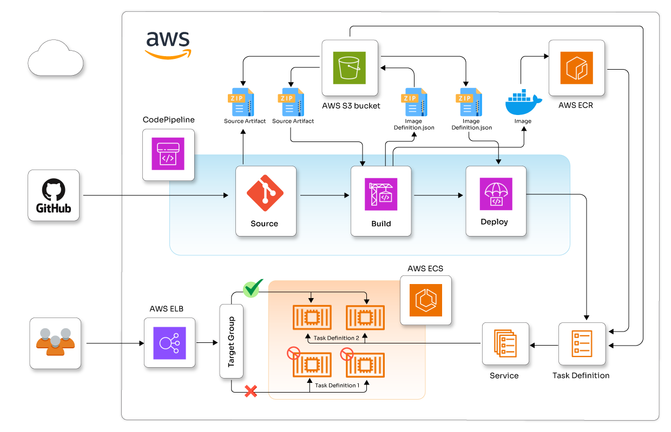

Slide 100
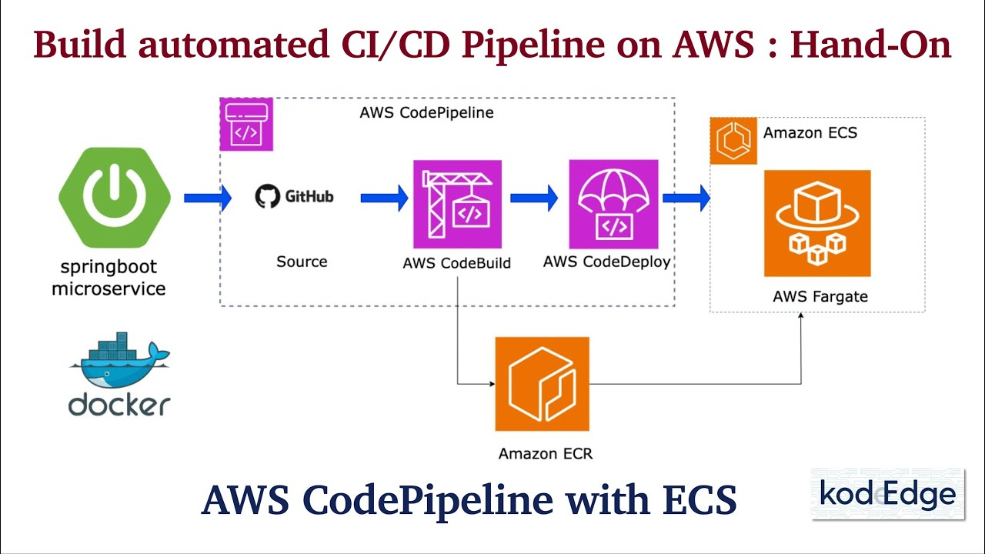

Slide 101
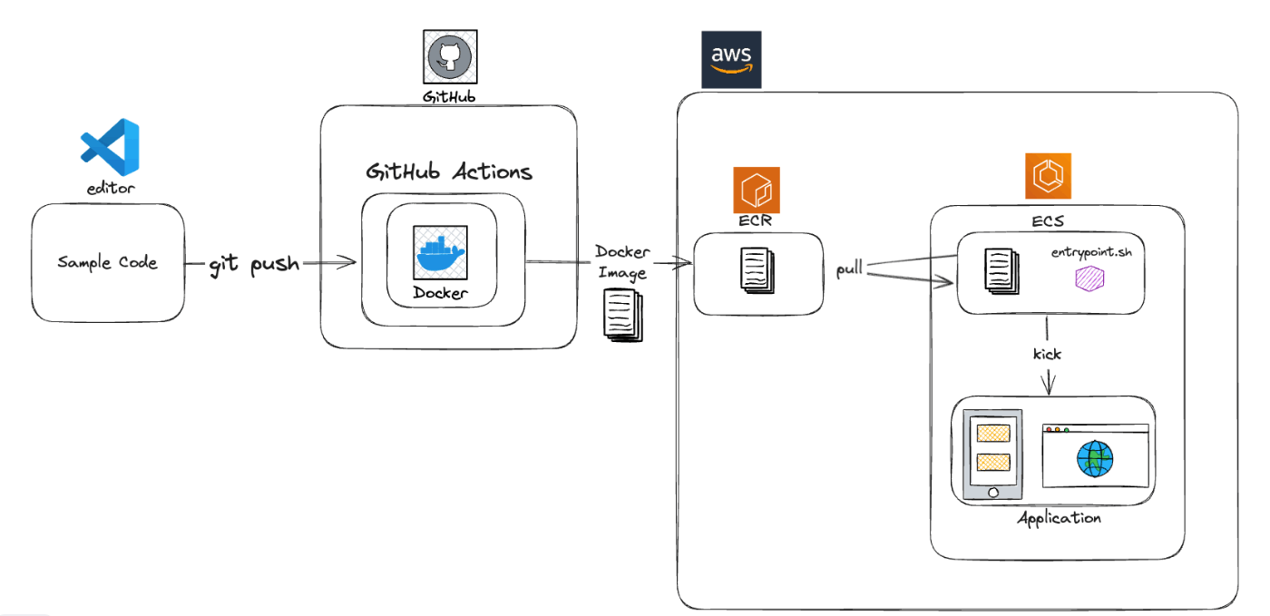

Slide 102


